Slide 1
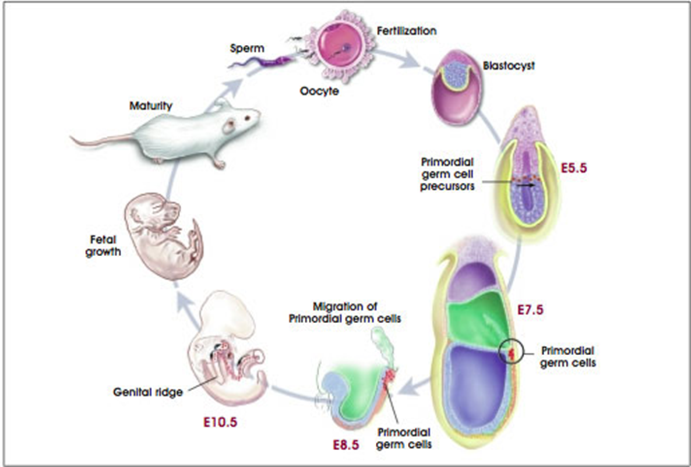
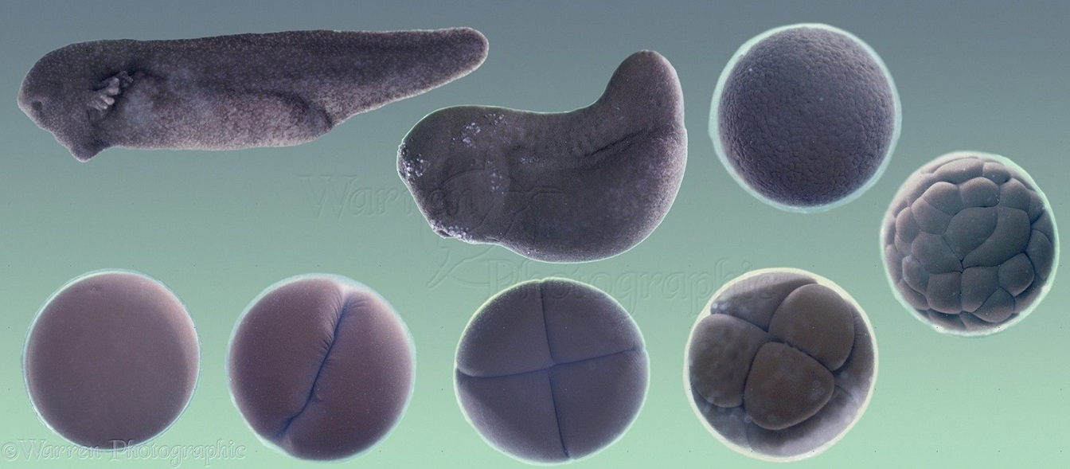
Developmental biology Biological process in which a fertilized cell forms a complex structure of adult body
How does the fertilized egg develop the complex adult body?
How do the cells differentiate into various cell type?
Which genes do involve in the process of development?
What is the mechanism that determines the shape of adult body?

Slide 2
What determines the shape of the animal body?
Gene expression
Behaviors of the cells
Proliferation
Migration
Differentiation
Specific shapes of cells
Cell-cell interaction
Shape of tissues
This process is not easy to understand

Slide 3
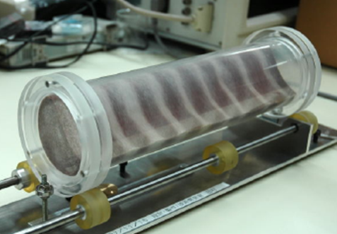
Separation of particulate objects
Please answer why this happens
Two kinds of glass beads (radius is different) are in the transparent cylinder.
An example in which the behavior of the whole can not be predicted even if the nature of the element is known

Slide 4
answer
angle of repose
Large beads
small beads
Green go down earlier than blue
Green moves to green region

Slide 5
What we need to know
cell
Predicting the outcome of single cell behavior is easy.
cell
cell
cell
cell
cell
cell
Predicting the outcome of single cell behavior is difficult.
cell
cell
cell
cell
cell
cell
We need physics (mathematical model, simulation)

Slide 6
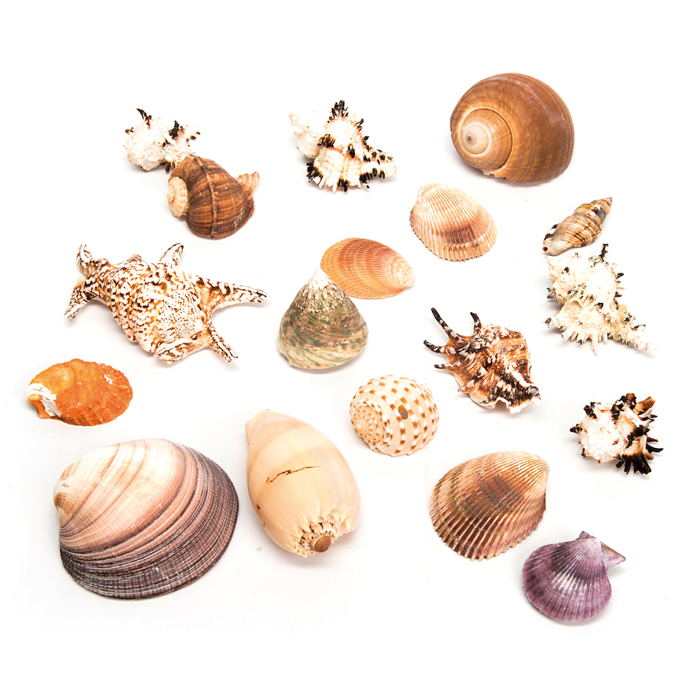
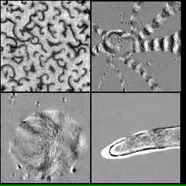
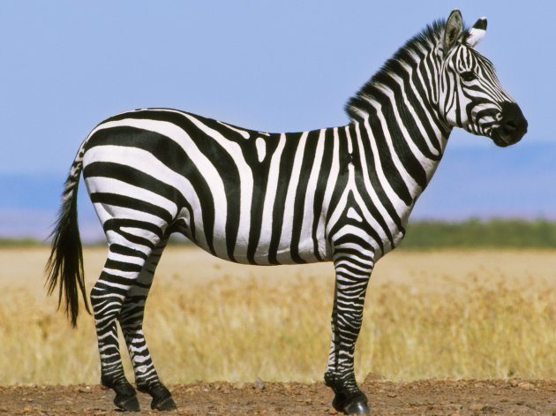
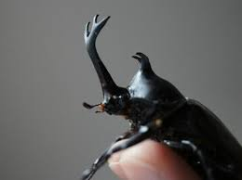
Four mechanisms we learn in this lecture
Travelling wave pattern
Spiral cones
Stable wave pattern
Origami Balloon

Slide 7
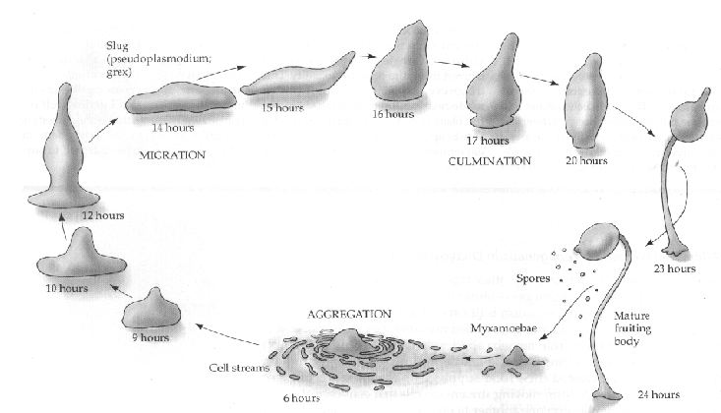
Cellular slime mold

Slide 8
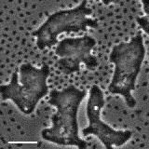
Cellular slime mold

Slide 9
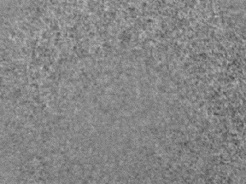
Cellular slime mold

Slide 10
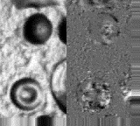
Cellular slime mold

Slide 11
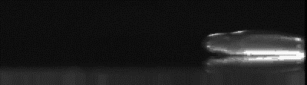
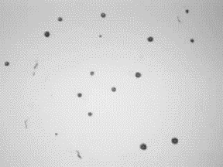
Cellular slime mold

Slide 12
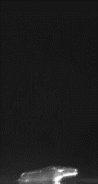
Cellular slime mold

Slide 13
In all process of development the travelling wave exists

Slide 14
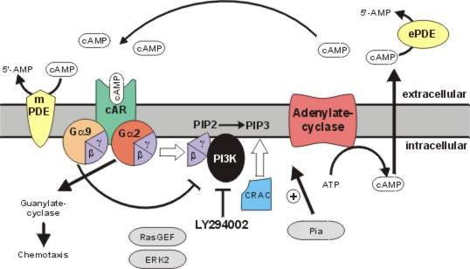
Wave is made by the cAMP signal
Deliver cAMP
Receive the cAMP signal
Cells move toward the direction of cAMP signal coming

Slide 15
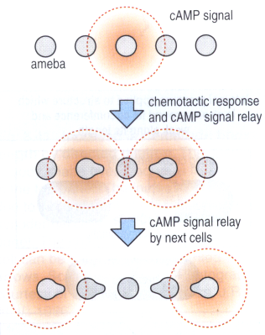
Relay of cAMP signal

Slide 16
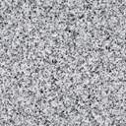
Migration of cells induced by cAMP
cAMP
cAMP release
migration
Freezing for a while

Slide 17
Simulation of travelling waves.
Download a program at
https://www.fbs-osaka-kondolabo.net/simulation-softs

Slide 18
What does happen to the aggregate of cells?
Center of spiral
Center of spiral is stable !

Slide 19
Migration as a slime

Slide 20
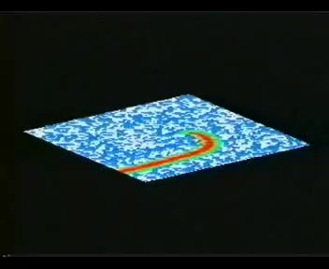
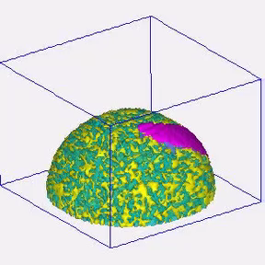
simulation

Slide 21
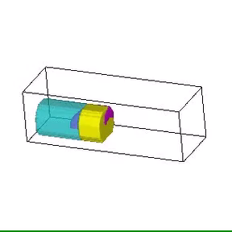
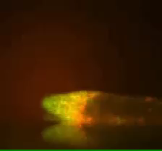
Cells are rolling in the slime

Slide 22
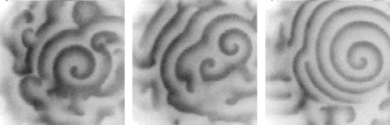
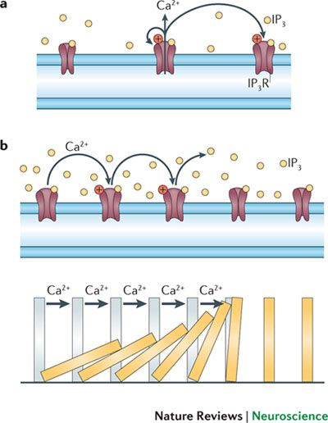
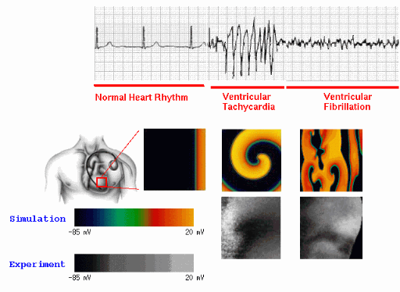
Calcium waves
Surface of oocytes
heart

Slide 23
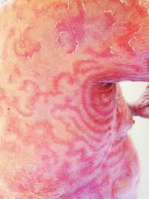
Examples of travelling wave pattern 2
erythema gyratum repens
Skin cell
Skin cell
Skin cell
Skin cell
Skin cell
cytokine
Skin cell
Skin cell
Skin cell
Skin cell
Skin cell
cytokine
cytokine
Skin cell
Skin cell
Skin cell
Skin cell
Skin cell
cytokine
cytokine
Skin cell
Skin cell
Skin cell
Skin cell
Skin cell

Slide 24
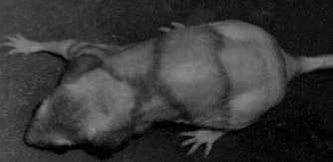
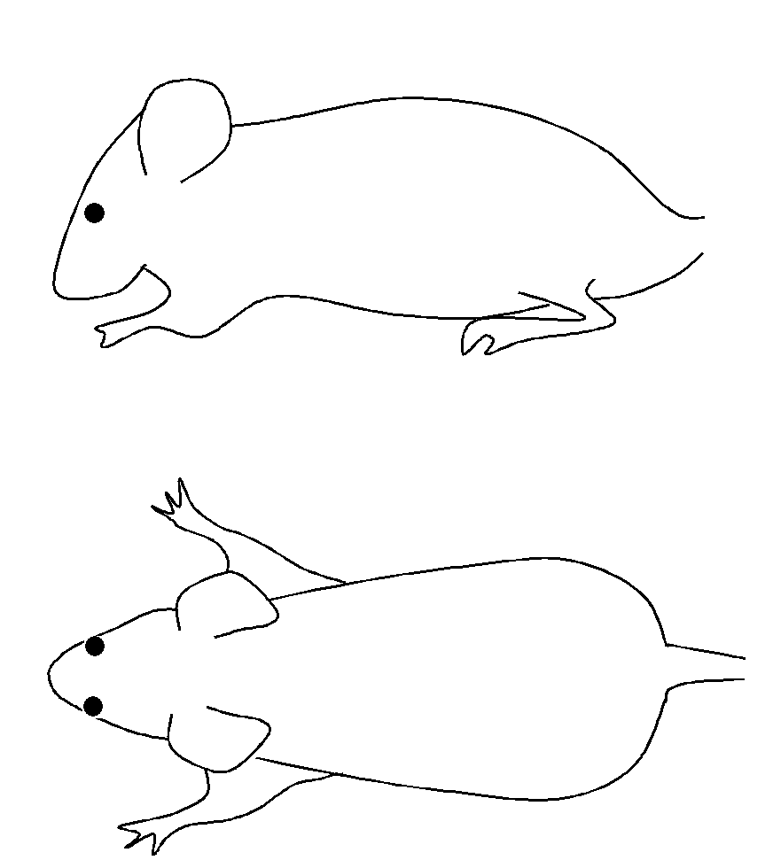
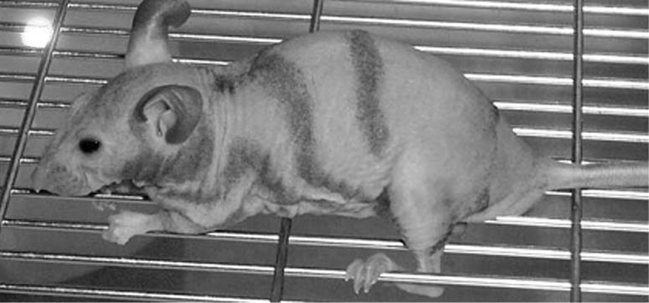
Movement of the hair waves
Similar to the dynamics of non-liner traveling wave (bz wave)

Slide 25
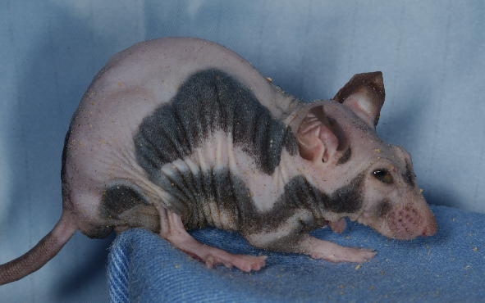

波が移動する理由
刺激
刺激
刺激
刺激
The hairs of this mutant mouse drop periodically

Slide 26
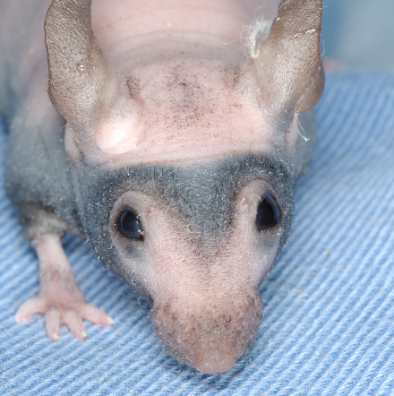
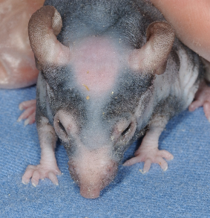
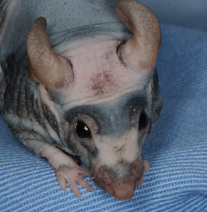
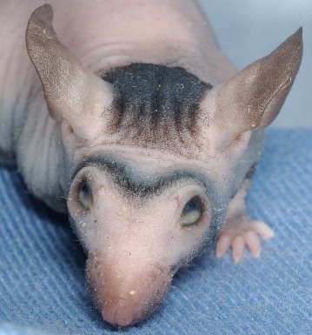
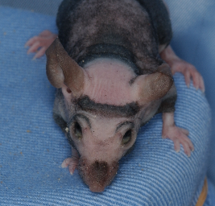
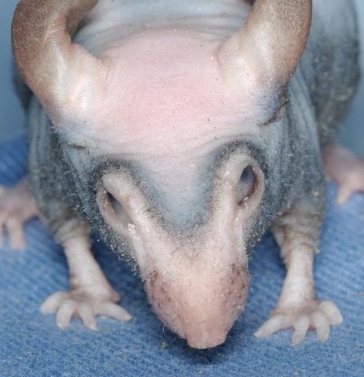
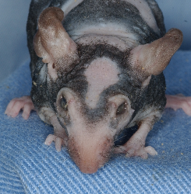
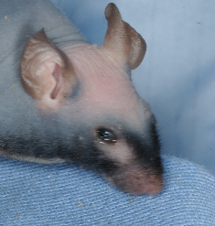
Patterns appearing in TB mouse are similar to those of some animals

Slide 27
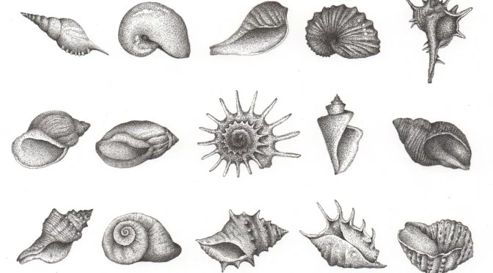
Apposition growth of sea shells Shells grow only at the edge of opening

Slide 28
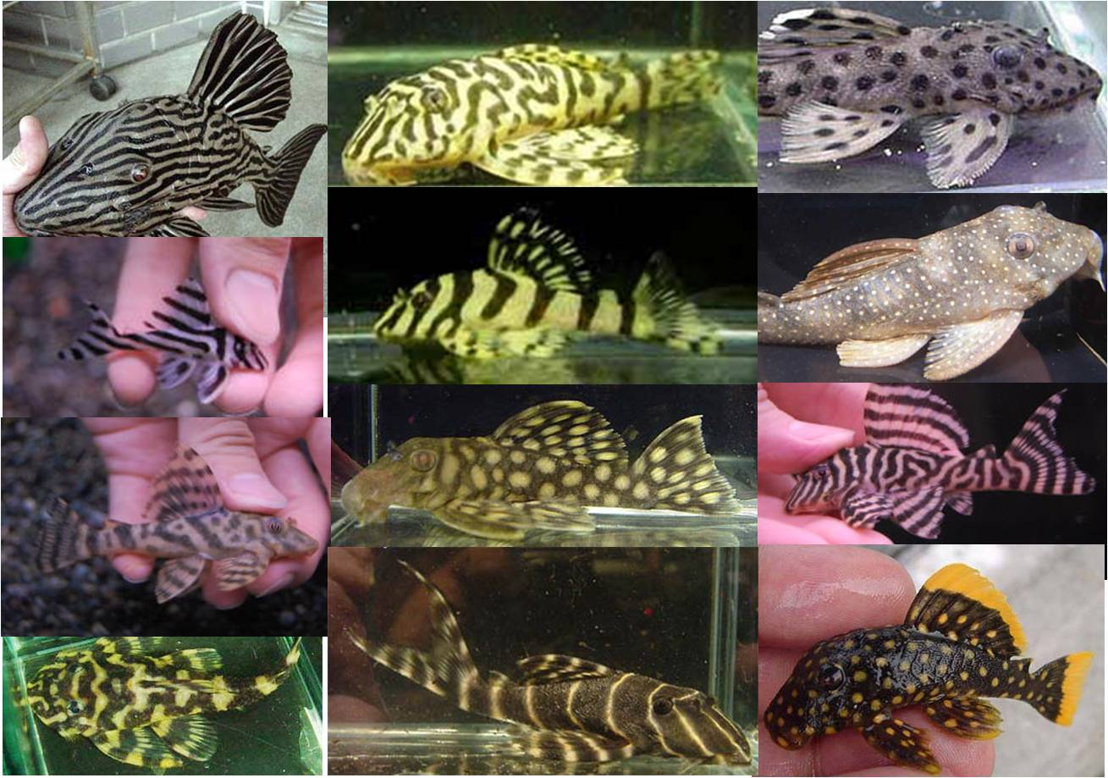
How are the pigmentation patterns made ?
Species in an identical family have variety of skin patterns.
>>An identical mechanism for many different pattern.

Slide 29
How are the pigmentation patterns made ?
No similar pattern exists beneath the skin.
>>Patterns are autonomously made in the skin.

Slide 30
How are the pigmentation patterns made ?
A common characteristic
>>periodicity

Slide 31
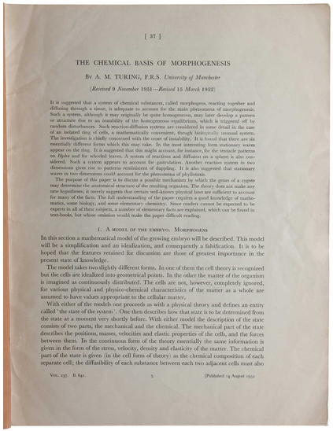
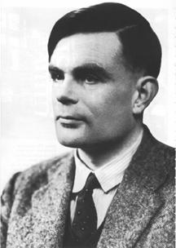
Turing’s mathematical hypothesis of biological pattern formation
The Chemical Basis
of Morphogenesis
(1952)
Alan Turing
Published 1952
Turing died 1954
Notes:
In 1952, Alan Turing presented a beautiful idea that explains the autonomous formation of spatial pattern in the embryo.
His idea is, in brief, combination of chemical reaction forms some wave in the embryo, and the wave functions as the positional information for development. 30

Slide 32

reaction-diffusion model <activator-inhibitor model>
activation
Local positive feedback
+
+
diffusion
activator
-
-
-
-
-
-
inhibition
inhibitor
Long range negative feedback
Turing pattern = RD pattern
Notes:
In 1952, Alan Turing presented a beautiful idea that explains the autonomous formation of spatial pattern in the embryo.
His idea is, in brief, combination of chemical reaction forms some wave in the embryo, and the wave functions as the positional information for development. 30

Slide 33
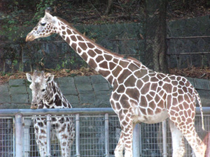
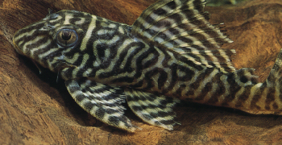
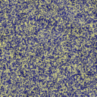

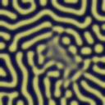
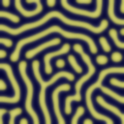
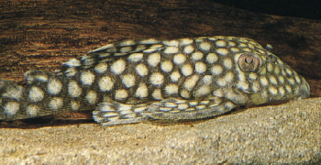
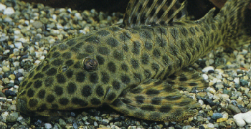
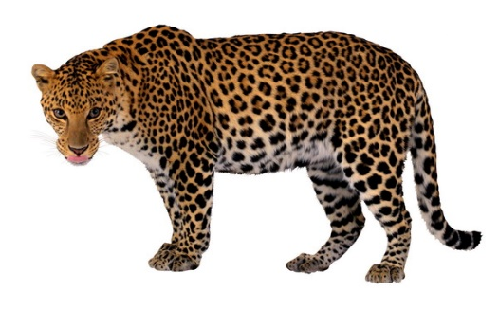
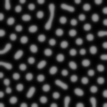




Properties of the Turing pattern in 2D simulation
1: Patterns form without prepattern
2: Autonomous regeneration
3: variety of patterns are generated by changing the parameters in the equation
quite useful to explain the skin pattern formation
Notes:
In 1952, Alan Turing presented a beautiful idea that explains the autonomous formation of spatial pattern in the embryo.
His idea is, in brief, combination of chemical reaction forms some wave in the embryo, and the wave functions as the positional information for development. 30

Slide 34
However,,,,,,
Reproduction of the already known patterns by simulation only suggests the possibility.
More clever way to use the simulation?
Predict something unknown>>show it by experiment
RD pattern = a kind of wave
>>It may move when some perturbation is given

Slide 35




Skin patterns of fish show specific dynamics of Turing pattern
simulation
day 0
day 40
day 90
Nature 1995; Kondo

Slide 36


Skin patterns of fish show specific dynamics of Turing pattern
simulation
PNAS 2007, Yamaguchi and Kondo
Notes:
@He ablated the melanophores of upper two dark stripes continuously by the laser radiation to replaced the melanophore by xanthophores.
Then observed how the pattern regenerates.
@this is the result.(ムービーを押す)
@You can witness the interesting phenomenon on this movie.
@The dark stripe creeped upper to maintain the even-spaced pattern.
And, of course, this result is consistent with the Turing model.

Slide 37

Skin patterns of fish show specific dynamics of Turing pattern
experiment
simulation
PNAS 2007, Yamaguchi and Kondo
Notes:
@He ablated the melanophores of upper two dark stripes continuously by the laser radiation to replaced the melanophore by xanthophores.
Then observed how the pattern regenerates.
@this is the result.(ムービーを押す)
@You can witness the interesting phenomenon on this movie.
@The dark stripe creeped upper to maintain the even-spaced pattern.
And, of course, this result is consistent with the Turing model.

Slide 38








Turing model predicts the pattern of hybrid fish
Change of parameter value

Slide 39
Next questions are,,,
What is the detailed cellular and molecular mechanism?

Slide 40


Skin pattern of zebrafish is made by the arrangement of three types of pigment cells
xanthophore
v
v
v
iridophore
melanophore
Interactions among the pigment cells are responsible for the pattern formation
Notes:
@ If you focus on the skin of the zebrafish, you can observe three types of chromatophores, which are the cells responsible for giving the skin its color
@ Black pigmented cells, melanophores, cluster to form the black stripes.
@ Yellow pigmented xanthophores constitute the interstripe region sandwiched between the black stripes.
@ In addition to these two types of chromatophores, there are glittering iridophores.
@ Each of these three chromatophores is distributed in a specific hypodermal layer.
@ The pigmentation pattern is clearly made up of melanophores and xanthophores.
@ So, in this presentation I will focus on these two types of chromatophores, which are responsible for forming the skin pattern.

Slide 41


Short range mutual inhibition between xanthophores and melanophores
Long range signal from xanthophores helps melanophores to survive

Slide 42

Which pigment cells are essential ?
Melanophores and Xanthophores >> major elements of pattern formation
Iridophores >> Not required in the fin. Supplementary element?

Slide 43


In vivo experiment to find the local interactions
M is surrounded by Xs
Nearest Xs are killed by laser
PNAS 2007 Nakamasu, Takahashi and Kondo

Slide 44






In vivo experiment to find the local interactions
PNAS 2007 Nakamasu, Takahashi and Kondo

Slide 45

In vitro experiment to find the local interactions
Pigment cells from wild type zebrafish
Mutual interaction by the tip of
yellow cell’s dendrites

Slide 46


Signal is transferred by the direct touch
Melanophore
(Albino)
xanthophore
Membrane potential indicator is in the medium
Science 2012; Inaba, Yamanaka and Kondo

Slide 47



Is this run-and-chase behavior causes the segregation of the pigment cells?
In jaguar mutant, segregation of the black and yellow cells is not complete.
Jaguar gene codes a potassium channel
, Kir7.1 expressed in melanophores
Melanophores do not run away from xanthophores.
Run-and-chase behavior should be correlated to the M-X segregation

Slide 48


In vitro behavior of the pigment cells from gap-junction mutant, leopard.
Leopard mutant has spot pattern.
The responsible gene, cx418 is expressed
in both melanophores and xanthophores.
Xanthophores are unable to sense melanophores.

Slide 49
Current hypothesis of short range interactions
In vivo
In vitro
?
Depolarization(Kir7.1)
Migration(in vitro, in vivo)
Apoptosis(in vivo)
Dendrite elongation
migration
?
Gap junction
cx418

Slide 50








In vivo experiment to find the long range interaction
Cells were ablated
Day 0
Day 3
Day 6
Long range help
PNAS 2007 Nakamasu, Takahashi and Kondo
Notes:
Figure 4. Xanthophore can survive by itself, but melanophore can’t keep their density without surrounding xanthophore.
(A,B) Schematics of laser ablation pattern to examine the influence of circumstance on existing pigment cells. Before (C,D) and 3days (E,F), 5days (G,H) after the treatment. Without neighbor stripe, xanthophore in the interstripe region is alone sufficient to maintain their density. On the other hand, melanophore eliminated adjacent interstripe die partially and disperse. Scale bars 500mm.
図2． 周囲の色素細胞を除去したとき、xanthophoreは単独でも存在し続けるが、melanophoreはそれまでの密度を保てず散在する。
ｘanthophoreでは、もとの細胞数が保たれ、それ以上に増加もおこる。多少移動して散らばる？
ｍelanophoreは、細胞死をおこしたり、移動したりで散在する。
Fig.2 (C,E,G) 070223c, (D,F,H) 060813d, (I,J,K) 061220b,
Scale bar 500 μｍ

Slide 51
Screening of the long range factor
Assumption
Ligand is expressed exclusively in xanthophores
Receptor is expressed exclusively in melanophores
~20,000 genes
Gene chip:
Xenthophores/melanophores > 3
482genes
Realtime PCR:
Xenthophores/melanophores > 5
+
Protein ligands or membrane proteins
6 genes
Transgenic fish:
Expression in melanophores
Alteration of the pattern?
1 gene

Slide 52










Delta-Notch system involves in the long range effect
control
Fin
β-actin
Control
(melanophore)
Control
(xanthophore)
DeltaC
+ Notch inhibitor(DAPT)
Notch1a
Notch1b
Notch2
Notch3
Xanthophores express DeltaC ligand
Melanophores express Notch1a receptor
Inhibition of Notch signal kills melanophores
Development 2014, Hamada et al.

Slide 53

Long range interaction by Delta and Notch ?

Slide 54

In vivo imaging of melanophore membrane
c
yellow stripe region
melanophore
melanophore
black stripe region
melanophore
yellow stripe region
xanthophores
long projections of melanophores enable the long range interaction
by the direct touch
Development 2014, Hamada et al.

Slide 55



In vivo imaging of melanophore membrane
Width of the stripes are almost the twice of the projection length.
Development 2014, Hamada et al.

Slide 56
Transgenic fish with DeltaC or Notch1a
Delta
γ-secretase
etc…
Notch
nuclear
2
Delta
NICD
1
transcriptional control
In both cases, melanophores will become less dependent to xanthophores.
Melanophores will survive in the region where xanthophores are far away.
Wider stripes or large spots ??

Slide 57



Ectopic expression of DeltaC or Notch1a-ICD caused wider stripes
WT
1
WT; DeltaC expressed in melanophores
2
Ectopic expression of Notch-ICD
in melanophore
Development 2014, Hamada et al.

Slide 58

To “tune” the activity of cx418, series of deletions at the amino-terminal are generated.
TM1
MKL418 MKLMADWSLLGSF LEEVQEHSTS VGKVWLTILF IFRILVLGTA AE
418(WT) MADWSLLGSF LEEVQEHSTS VGKVWLTILF IFRILVLGTA AE
418del-6 MGSF LEEVQEHSTS VGKVWLTILF IFRILVLGTA AE
418del-10 MEEVQEHSTS VGKVWLTILF IFRILVLGTA AE
418del-14 MEHSTS VGKVWLTILF IFRILVLGTA AE

Slide 59












Pigment cell melanoma Res.. 2012 Watanabe et al.
Wild type
Leopard t1
+3 AA at N-terminal
+3 AA in leopard
wt on melanophore
Leopard TW28
All varieties of patterns were generated by changing the activity of a single gene.

Slide 60
Identified Mechanism
Long projection
Delta-notch
Kir7.1
Short projection
Cx418(gap junction)
It looks substantially different form the original RD model.
If so, why the RD model was able to predict the pattern dynamics correctly?

Slide 61
Identified network is similar to the Turing model.
Survival is enhanced
by long projection
Positive feedback
Local
Negative feedback
Long range
Repulsion
by short dendrites
local positive feedback
+
long range negative feedback
Difference in the projection length replaces the effect of diffusion

Slide 62


Quiz Turing Pattern
?

Slide 63
Turing model predicts the pattern of hybrid fish
Change of parameter value

Slide 64
Zebra vs Horse
?

Slide 66





small
Dw
large

Slide 67

Zebra vs Horse
Contrast: weak
Spacing :narrow
Dw:length of long range effect
small
Dw
large

Slide 68










Wide
High contrast
Grevey Zebra
Narrow
(more number)
Low contrast
Zonkey
No stripe
Uniform
Intermediate color
Donkey

Slide 69
small
Dw
large

Slide 70






Zebra has lost the uniform color
mutation
mutation
short
No Long-range interaction
long

Slide 71
Four mechanisms we learn in this lecture
Travelling wave pattern
Spiral cones
Stable wave pattern
Origami Balloon

Slide 72




How do they grow?

Slide 73

Apposition growth of sea shells and horns Shells grow only at the edge of opening
Only the edge part grows by apposition

Slide 74

All the shells are made by an identical method

Slide 75


Slide 76


Slide 77
All the shells are made by an identical method

Slide 78

Parameters determining the shape
Basic structure is a cone shape
Angle of growth
bending
twisting

Slide 79

How to make the coiling of sea shells
Bend more
Bend more and more
bend
Let us begin from the straight cone
Rotate 90*
Twist more
twist
Shell is completed

Slide 80



Make these spirals

Slide 81

How to make the Bivalvia
Size of the shells differs but the shape is identical. How do they grow?

Slide 82
Can you make the clams?

Slide 83

How to make the Bivalvia
Shift the peak position
bend
Bend more
A clam is made
Let us begin from a wide cone
From different angles

Slide 84





Horns are also made by the same method

Slide 85

question1
Twist > 0
Twist = 0
Why the mollusks get twisted?
What is the merit?

Slide 86


The most important role of the shell is to guard the mollusk body from the predators.
creeping on the bottom of the sea.
swimming in the sea.
Twisting make the mollusk possible to bind the body more tightly.

Slide 87

Question 2 Why do some of the mollusks have protrusions?

Slide 88


Now you are a mollusk. How do you feel this situation?
Position of the body when moving
Center of gravity
Center of gravity
Center of opening

Slide 89

Protrusion changes the position of the gravity center

Slide 90



Center of gravity without protrusions
Center of gravity with protrusions

Slide 91





Parameters are sometimes flexible.
Mollusks are able to change the parameters on purpose ?

Slide 92

Land snail in Borneo
Question：Guess the meaning of this strange coiling.
Land snail, lives in caves, environment is wet, eats leafs and fungi

Slide 93



Odd coiling of ammonites Nipponites mirabilis

Slide 94

１
２

Slide 95


Slide 96

Shape of Nautilus’s shell and the body angle to swim
Spiral is good to keep the angle and gravity center

Slide 97


Slide 98


Slide 99
Land snail in Borneo
Question：Guess the meaning of this strange coiling.
Land snail, lives in caves, environment is wet, eats leafs and fungi

Slide 100


Notes:
突然ですが、みなさん。折り紙とは何でしょう？
子供の遊び？
願かけのシンボル？
確かに、そんな印象もある。
三角飛行機とかツルとかの、単純なものを目にすることが多いので、見くびってしまいがちだが、世の中には、超絶折り紙という世界が有るのです。
どんな世界かというと、こんな世界です。
どうです？
ほんまに折り紙か？？
もはや、呆れるしかないレベルでしょう。
どうやって折るのか教えてくれっ、と言うひとにはこれをどうぞ。カマキリの展開図です。

Slide 101
Origami: a simple method to form 3D structure from 2D sheets
adding a 2D pattern
Folding along the pattern
2D sheet
3D structure
101

Slide 102





Similar phenomena in development
Folding of cell sheet
Unfolding of cell sheet
A 3D structure
Unfolding the folded cell sheet generates 3D morphogenesis
Reversed Origami Method
Proliferation, cell death, change of cell shape and convergent extension also contribute,,,

Slide 103


Horn primordia of Japanese beetle
Notes:
ば～～～ん。どーです？一見して、オーラを感じませんか？
皺の数もすごければ、個々の皺も複雑に折れ曲がっていて、訳が解らない。
で、これが伸びると、
こうなる。
まず、こんな長いものが、ぎゅ～～～っと圧縮されて、幼虫の頭の中に納まっていることもすごいが、こんな変な折り方をしたものが伸びると、なぜ、こんなにもスムーズで優美な形になるのかが意味不明だ。
この訳のわからなさ加減は、まさに超絶折り紙をほうふつとさせて素晴らしい。
このカブトムシの原基も、１枚の細胞シートの折り畳みである。

Slide 104


Development of beetle horn
Metamorphosis from the primordium to the pupa horn occur within 100 minutes

Slide 105

Inside of the primordium is empty
The horn primordia were dissected and inside of them were washed by water

Slide 106


Expansion of the primordia in the computer
3D furrow pattern is reconstructed in the computer

Slide 107

3D folding of the cell sheet codes the 3D structure of beetle horn

Slide 108

Furrow formation of the horn primordia
Epithelial cell sheet
secondary folding
(micro)
Primary furrow
Secondary furrow
Primary folding
(macro)

Slide 109






Furrow pattern varies for each region
parallel
X shape
??
Zigzag?

Slide 110
Relationship between the furrow pattern and the resulting 3D shape
parallel
X shape
??
Zigzag?

Slide 111




Relationship between the furrow pattern and the resulting 3D shape
Saddle shape
Leaned doom?
parallel
X shape
??
Zigzag?

Slide 112




Furrow patterns
….
A
B
C
D
E
F
B
B
A
A
F
B
C
C
B
D
D
Different combination generates different 3d shape
Next, we need to the mechanism to determine the furrow pattern

Slide 113

What determines the position of the primary folding to occur?
INK
Position of the primary folding is determined by the cell adhesion to the outer cuticle

Slide 114


Artificial manipulation of the horn shape by RNAi

Slide 115




RNAi with Dachsous gene
Primary folding become shallower

Slide 116


WT
ds

Slide 117



Directionality of cell division is lost by the knockdown of Dachsus gene
90
60
30
0
angle of the cell division is observed
Directionality is lost in ds KD

Slide 118


Knockdown of ds does not change the secondary furrows

Slide 119



Before the furrows emerge, actin accumulate at the apical membrane
Early stage primordium
F-actin is visualized
by phalloidin-GFP
The primary and secondary furrows are made by the different mechanism

Slide 120






Treehoppers
Surprisingly varied and complex shapes of treehopper helmets

Slide 121


Slide 122








Two species of treehoppers collected in CostaRica(2017)
Antianthe
Larva
Adult
？
→
Helmet gets bigger, spines are lost
Bocydium
？
→
Helmet gets bigger, complex structure emerges

Slide 123



Antianthe
Obtained ~300 last instar larvae.>> microCT
The oberved samples were freeze-dried.
（Fixed by 10% formalin → dehydration by
50,70,90,100EtOH → t-BtOH replacement → freeze-dry）
Process of helmet primordia development is assumed by the CT image

Slide 124







The process of develoment of the helmet
Antianthe
adhesion?
young
shrinking process
swelling process
adult
Development process can be devided into two process ; Shrink and Bulge

Slide 125







SEM analysis
young
Shrink process
Bulge process
adult
Epithelial cell sheet is flat

Slide 126
SEM analysis
young
Shrink process
Bulge process
adult
Fine and deep furrows. Some directionality is evident.

Slide 127


Directionality of the furrows
At the edges of the primordia, furrows are parallel. In other region, furrows do not look directional.

Slide 128






Slide 129


Why do larval thorns disappear in adult?
Larvae has thorns, but adult does not.
Just before molting

Slide 130

a simple way to make the thorn disappear ???
extension of
the folding
larva
adult

Slide 131


Slide 132


Slide 133


Slide 134


